Slide 1
6. Maxwell’s Equations In Time-Varying Fields
7e Applied EM by Ulaby and Ravaioli

Slide 2
Chapter 6 Overview

Slide 3
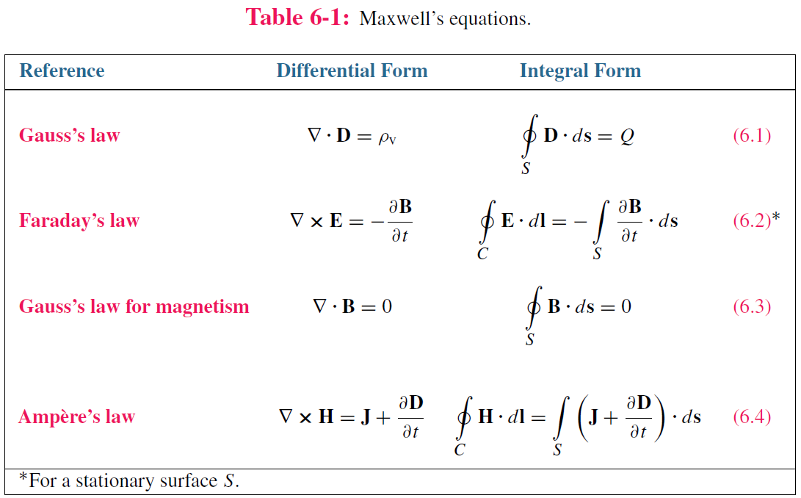
Maxwell’s Equations
In this chapter, we will examine Faraday’s and Ampère’s laws

Slide 4
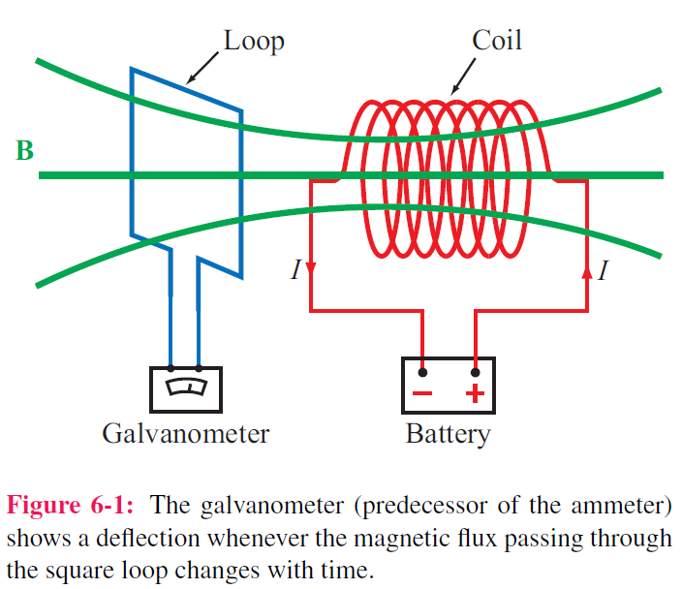
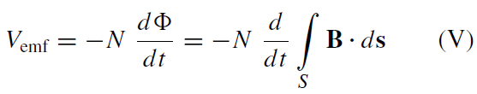
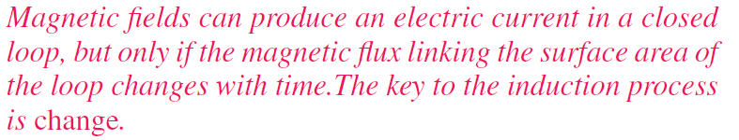
Electromotive Force
Electromotive force (voltage) induced by time-varying magnetic flux:

Slide 5
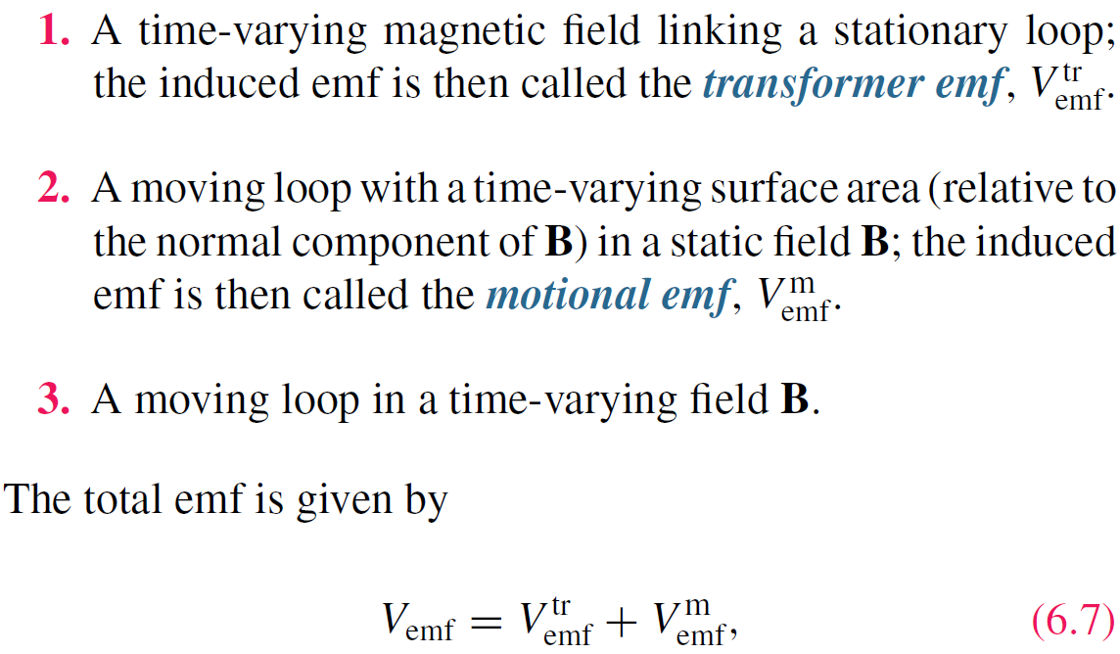
Three types of EMF

Slide 6
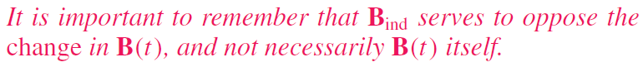
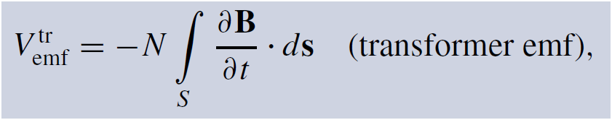
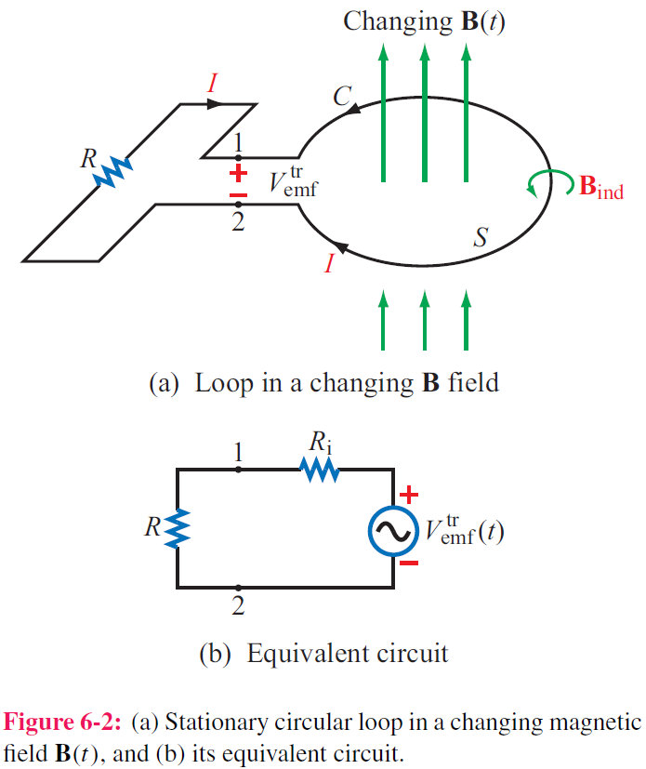
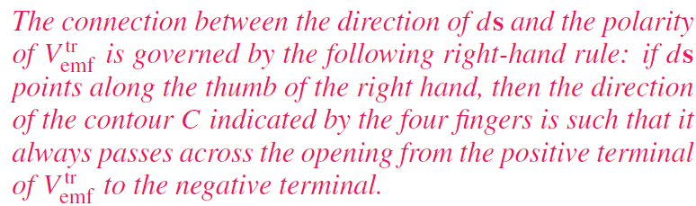
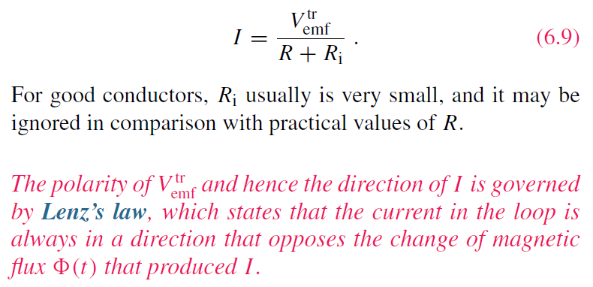
Stationary Loop in Time-Varying B

Slide 7
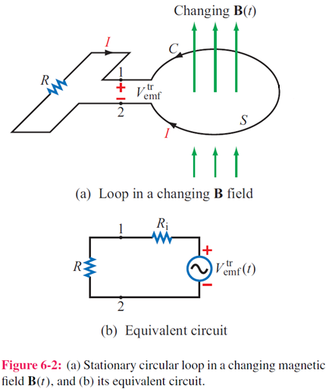
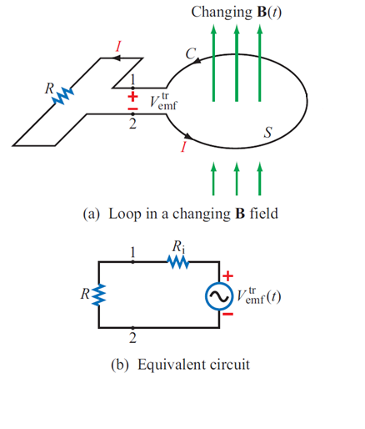
Lenz’s Law
B increases
B decreases
B_{ind}
B_{ind}
<0
>0
B_{ind} serves to oppose the change in B(t), and not necessarily B(t) itself

Slide 8
Faraday’s Law
Establish a link between B and E
Integral form of Faraday’s law
Stokes’s theorem

Slide 9
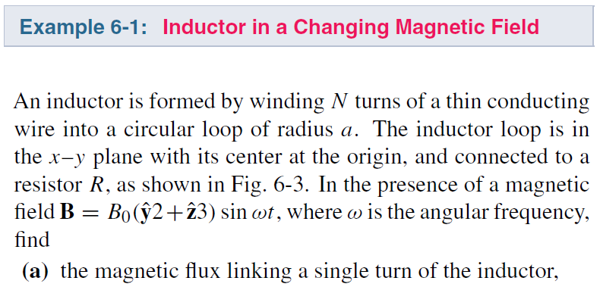
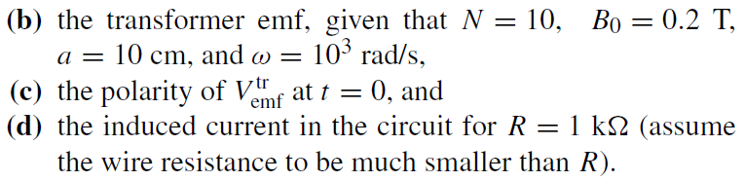
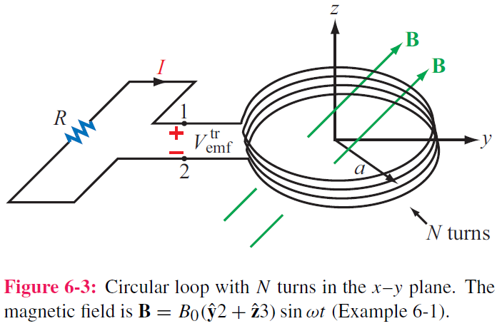
cont.

Slide 10
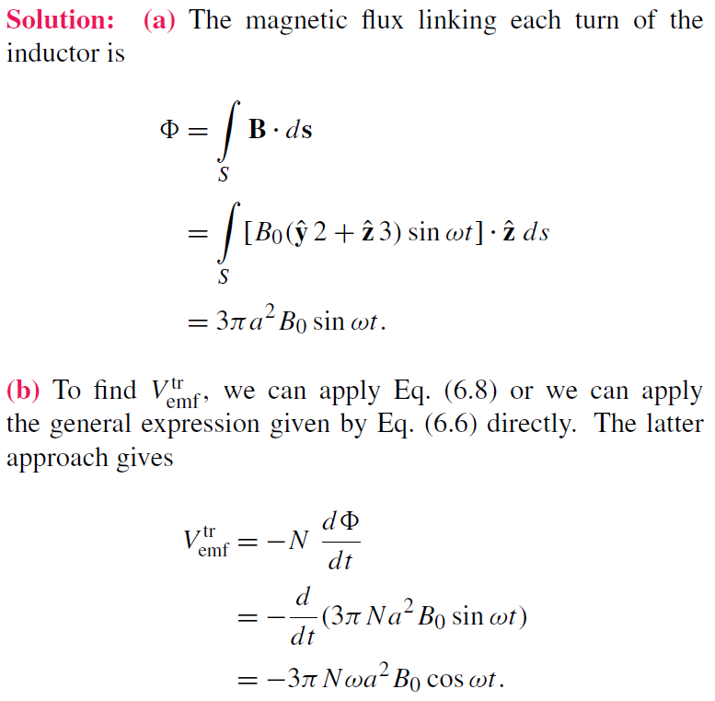
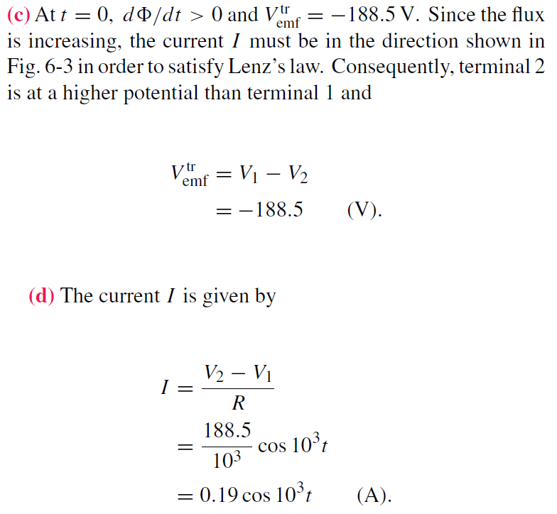
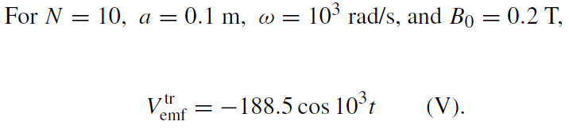
Example 6-1 Solution

Slide 11
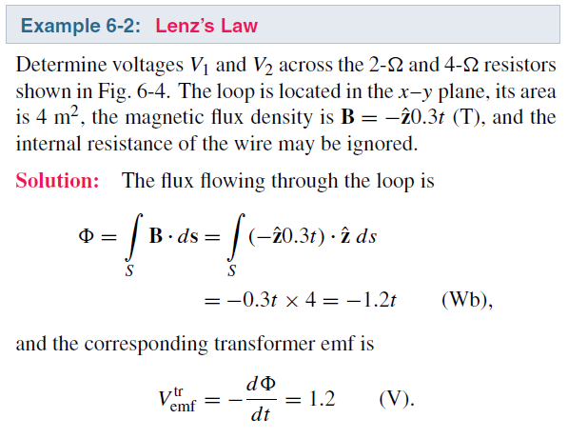
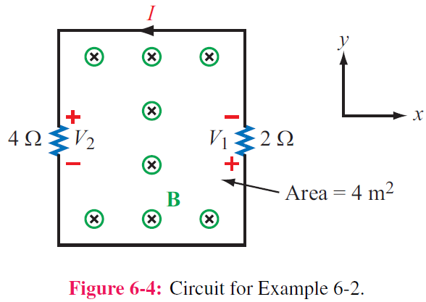
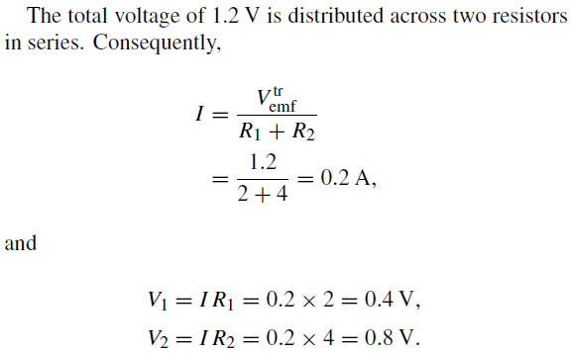

Slide 12
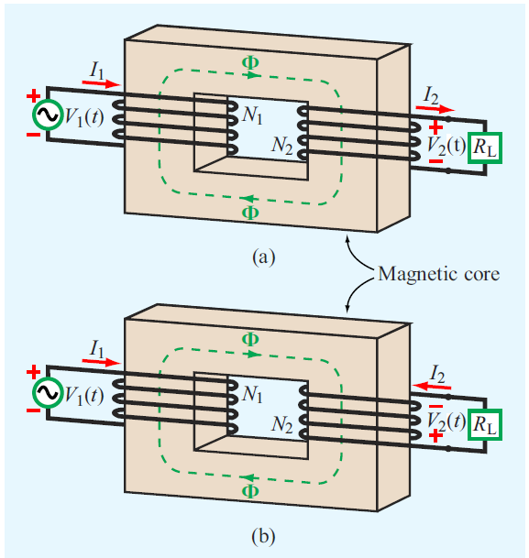
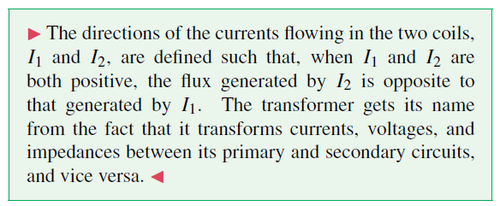
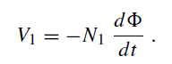
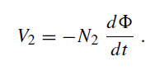
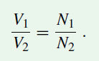
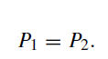
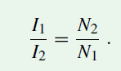
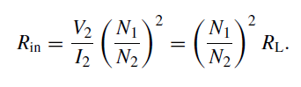
Ideal transformer
Transformer is used to convert the AC voltage from one voltage to another. An ideal transformer has infinite permeability, and the magnetic flux is confined within the core.

Slide 13
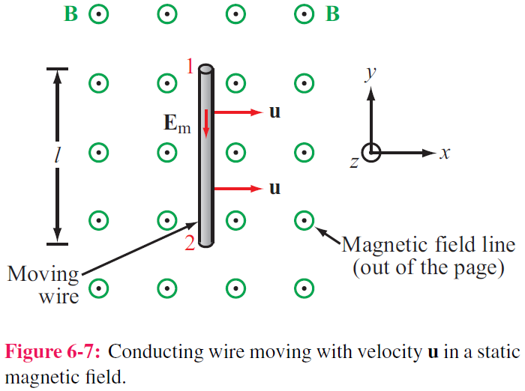
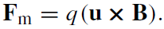
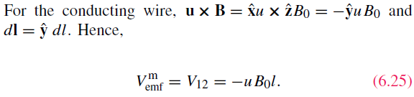
Motional EMF
Magnetic force on charge q moving with velocity u in a magnetic field B:
This magnetic force is equivalent to the electrical force that would be exerted on the particle by the (motional) electric field Em given by
This, in turn, induces a voltage difference between ends 1 and 2, with end 2 being at the higher potential. The induced voltage is called a motional emf
E points from 1 to 2

Slide 14
Motional EMF

Slide 15
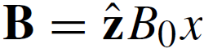
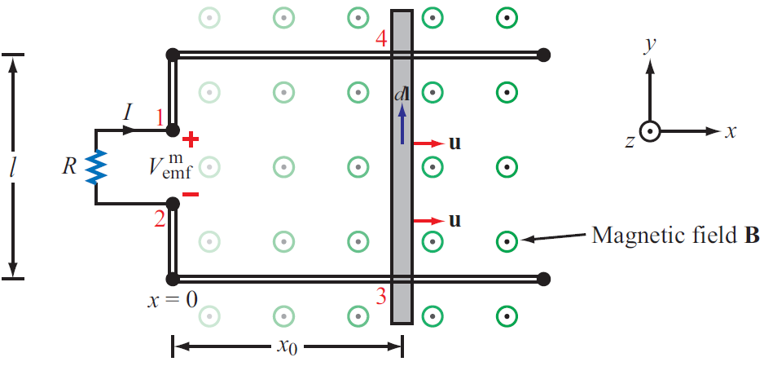
Example 6-3: Sliding Bar
Note that B increases with x
The length of the loop is related to u by x0 = ut. Hence
How to define the polarity of V_{emf} in this condition?

Slide 16
Example 6-3: cont.
Use Faraday’s law
Note that B increases with x
The same as the result obtained by the motional emf expression

Slide 17
Example 6-4: Moving Loop

Slide 18
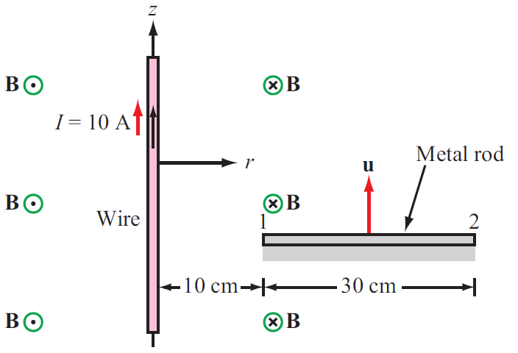

Slide 19
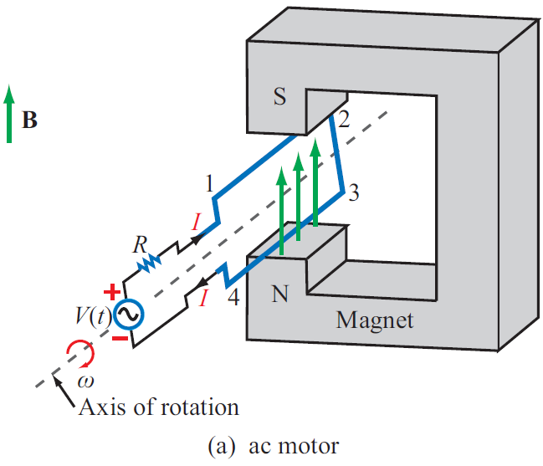
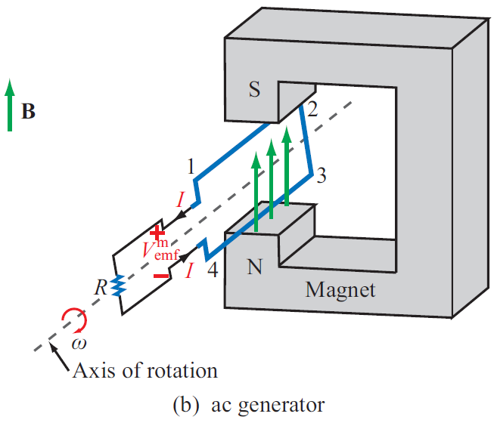
EM Motor / Generator Reciprocity
Motor: Electrical to mechanical energy conversion
Generator: Mechanical to electrical energy conversion
Wires with current are subject to force exerted by magnetic field
Time varying magnetic flux induces current in circuit

Slide 20
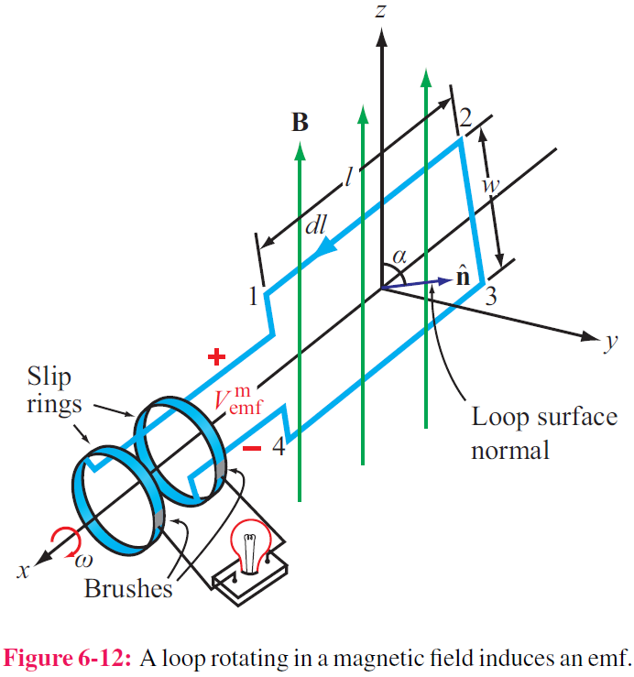
EM Generator EMF
As the loop rotates with an angular velocity ω about its own axis, segment 1–2 moves with velocity u given by
Also:
Segment 3-4 moves with velocity –u. Hence:

Slide 21
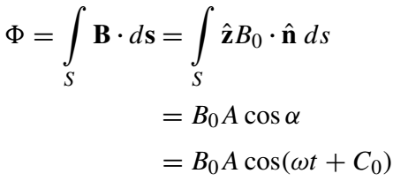
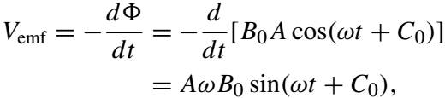
Another Way

Slide 22
Moving Conductor in Time-Varying Magnetic Field
Equivalent

Slide 23
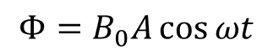
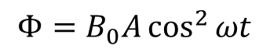
Example 6-6
$$Φ=B_{0}A\cos{ωt}$$
From p. 20
$$Φ=B_{0}A\cos^{2}{ωt}$$

Slide 24
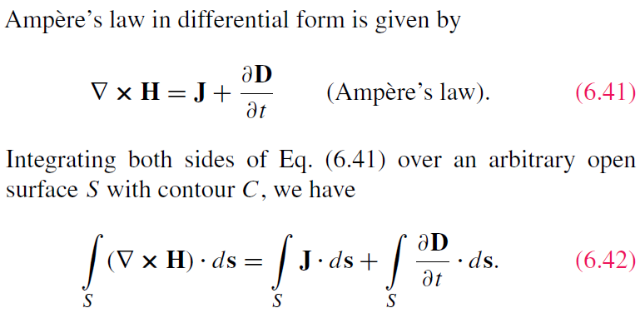
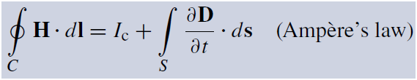
Displacement Current
This term is conduction current I_{C}
This term must represent a current
Application of Stokes’s theorem gives:
Cont.

Slide 25
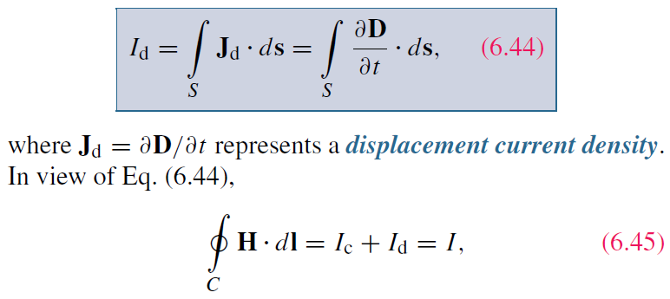
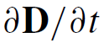
Displacement Current
Conduction current density
Define the displacement current as:
Displacement current density
The displacement current does not involve real charges; it is an equivalent current that depends on

Slide 26
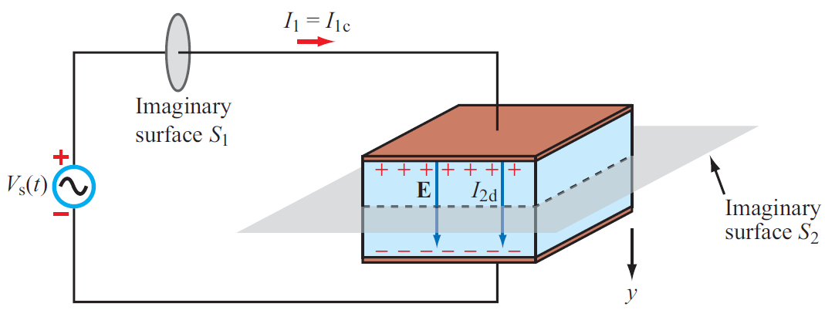
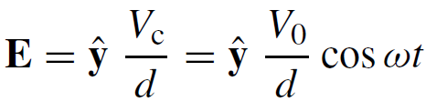
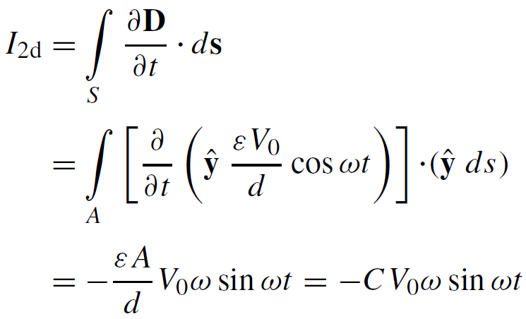
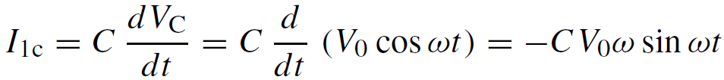

Capacitor Circuit
Given: Wires are perfect conductors and capacitor insulator material is perfect dielectric.
For Surface S₂:
I₂ = I_{2c} + I_{2d}
I_{2c} = 0 (perfect dielectric σ = 0)
For Surface S₁:
I₁ = I_{1c} + I_{1d}
(D = 0 in perfect conductor)
I₁ = I₂ ensures the continuity of total current flow through the circuit
Although the displacement current does not
transport free charges, it behaves like a real current
Conclusion: I₁ = I₂
p298

Slide 27



Slide 28

Boundary Conditions

Slide 29





Charge Current Continuity Equation
Current I out of a volume is equal to rate of decrease of charge Q contained in that volume:
Volume current density
Used Divergence Theorem

Slide 30
Charge Current Continuity Equation
Net current flowing out of ΔV is zero

Slide 31





Ampère’s Law for Dynamic Fields
In case the charge density does not change with time
$$0=∇∙J$$
$$∇∙\left(∇×H\right)=∇∙J=0$$
In case the charge density changes with time
Need to add a term for dynamic field
$$∇∙\left(∇×H\right)−\frac{∂ρ_{v}}{∂t}=∇∙J$$
$$∇∙\left(∇×H\right)−\frac{∂\left(∇∙D\right)}{∂t}=∇∙J$$
Added by Maxwell

Slide 32
Charge Dissipation
Question 1: What happens if you place a certain amount of free charge inside of a material?
Answer: The charge will move to the surface of the material, thereby returning its interior to a neutral state.
Question 2: How fast will this happen?
Answer: It depends on the material; in a good conductor, the charge dissipates in less than a femtosecond, whereas in a good dielectric, the process may take several hours.
Derivation of charge density equation:
Cont.

Slide 33
Solution of Charge Dissipation Equation
For copper:
For mica:
= 15 hours

Slide 34










EM potentials
In static case
In dynamic case
Introduce an equivalent E’

Slide 35





EM Potentials
Static condition
Dynamic condition
Dynamic condition with propagation delay:
Similarly, for the magnetic vector potential:

Slide 36










Time Harmonic Potentials
If charges and currents vary sinusoidally with time:
Also:
we can use phasor notation:
with
Maxwell’s equations become:
Expressions for potentials become:

Slide 37

Cont.

Slide 38

Cont.

Slide 39

Example 6-8 cont.
(6.90)
Cont.

Slide 40

Example 6-8 cont.

Slide 41

Summary
Homework due XXX

